Slide 1
Tableau detailed visual analysis

Slide 2
1)Duplicate the profit map and rename as negative profit map.
2) Represent the profit map in horizontal bar format.
3) Show only the states having negative profit in the bar graph.
4) On the Rows shelf, click the plus icon on the State field to drill-down to the City level of detail. 5)Show profit subcategory wise for all the states and city having negative profit.
6)Show the profit in different colour.
7) Check the profit in 2020 & 2021.
8)Find some meaningful information and suggest how can we increase the profit.

Slide 3
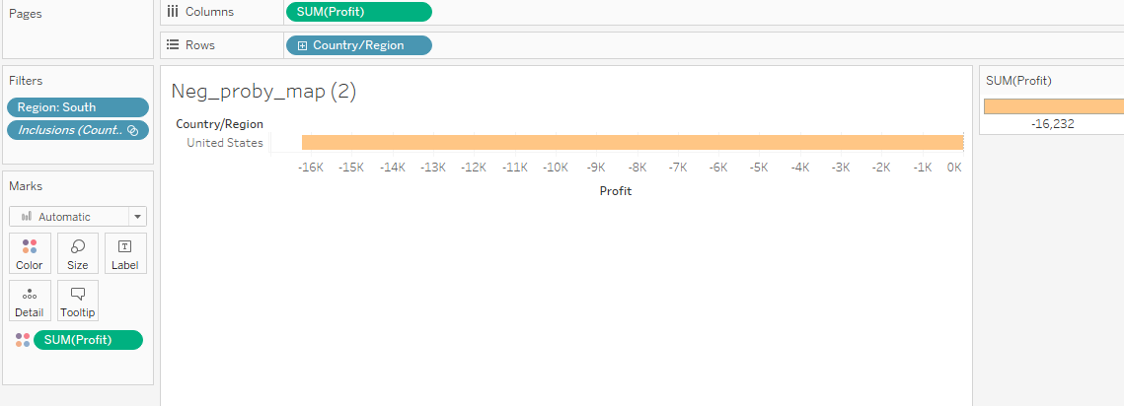
1)Duplicate the profit map and rename as negative profit map.

Slide 4
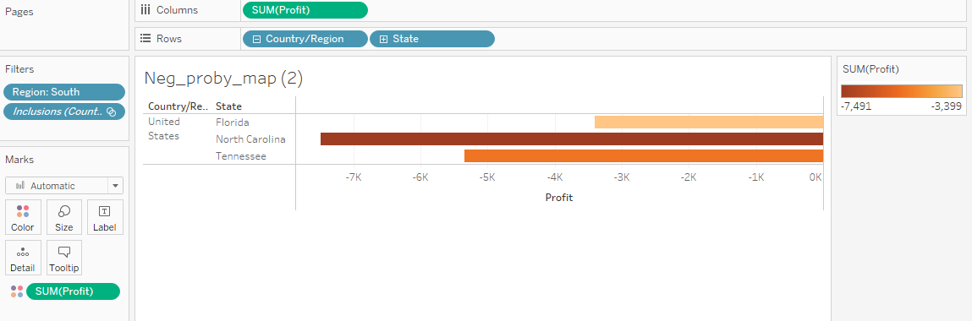
2)represent the profit map in horizontal bar format.

Slide 5
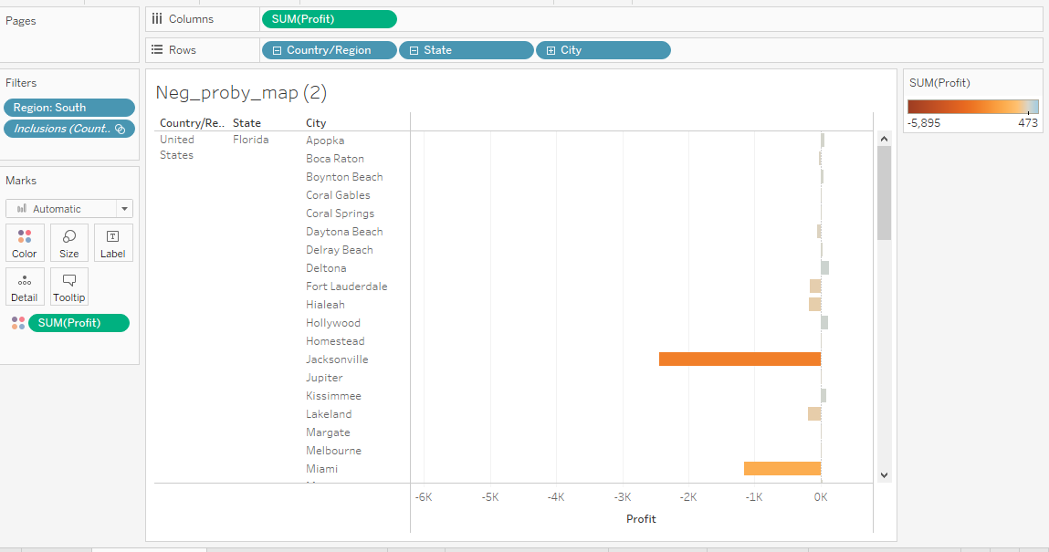
3)show only the states having negative profit in the bar graph

Slide 6
4) On the Rows shelf, click the plus icon on the State field to drill-down to the City level of detail.
5) Show profit subcategory wise for all the states and city having negative profit.
6)Show the profit in different colour.

Slide 7
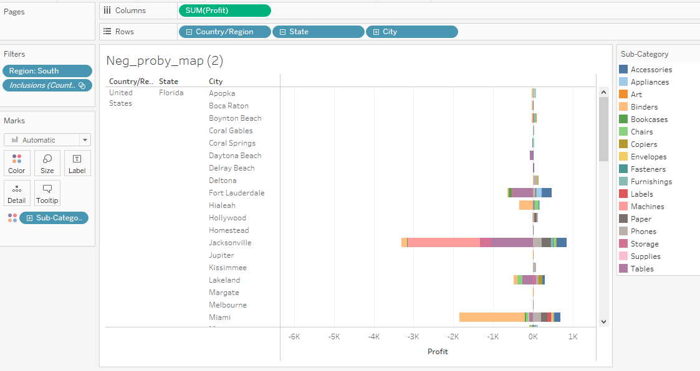

Slide 8
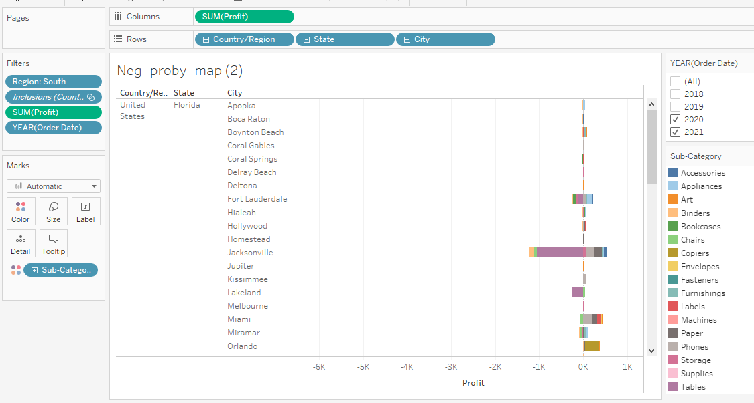
7)check the profit in 2021 & 2021

Slide 9
8) Find some meaningful information and suggest how can we increase the profit.
If we observed subcategory wise , machine is the recorded highest negative profit (-3840) and recorded highest positive profit(3874). And so focusing on sales under subcategories may improve the overall profit in region .

